Slide 1
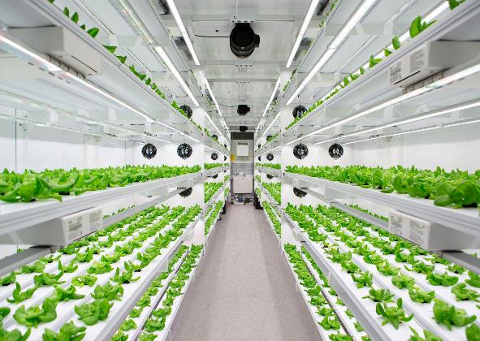



New Water Sources for Controlled Environment Agriculture
David A. Ladner¹
Weiming Qi¹
Abayomi Alayande¹
Jing-Hua Tzeng¹
Byoung Ryong Jeong²
Gary L. Amy¹
Seungkwan Hong³
Morgan Tomlin¹
Hyun Uk Cho²
Shashi Kant¹
Raghupathy Karthikeyan¹
Saylen Sofia Paz¹
Diana Vanegas¹
Jeff Adelberg¹
Clinton Williams⁴
¹ Clemson University
² Gyeongsang National University
³ Korea University
⁴ USDA Agricultural Research Service
Notes:
This talk fits in with Myra Reece’s talk. Thinking about the future of water resources in South Carolina.

Slide 2
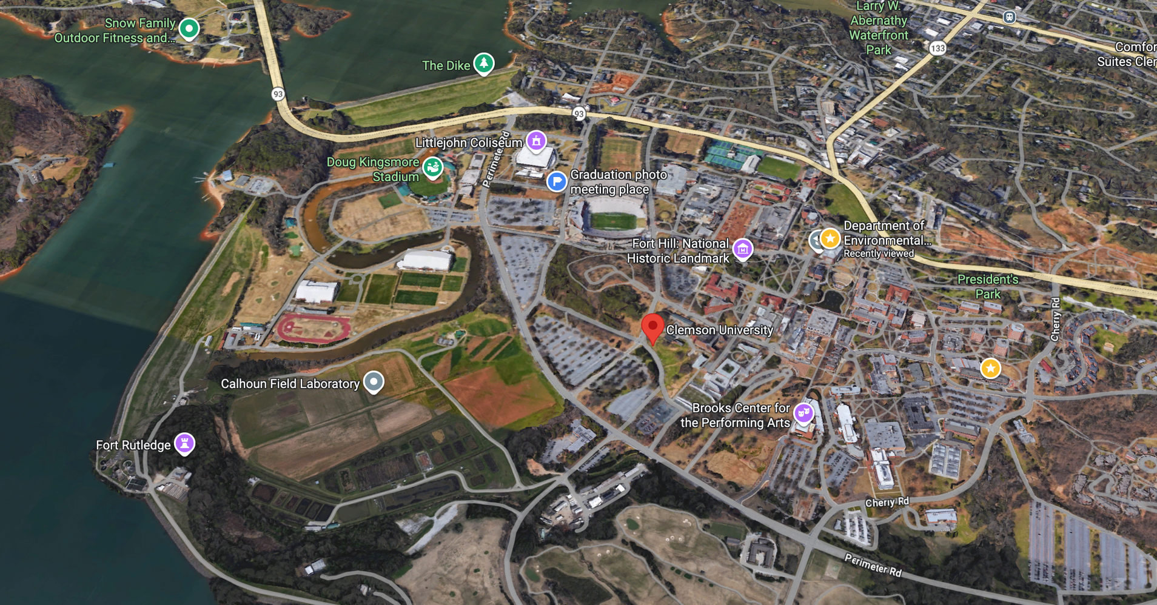
Clemson University, Clemson, SC
Notes:
Clemson infrastructure. River to lake/reservoir.

Slide 3
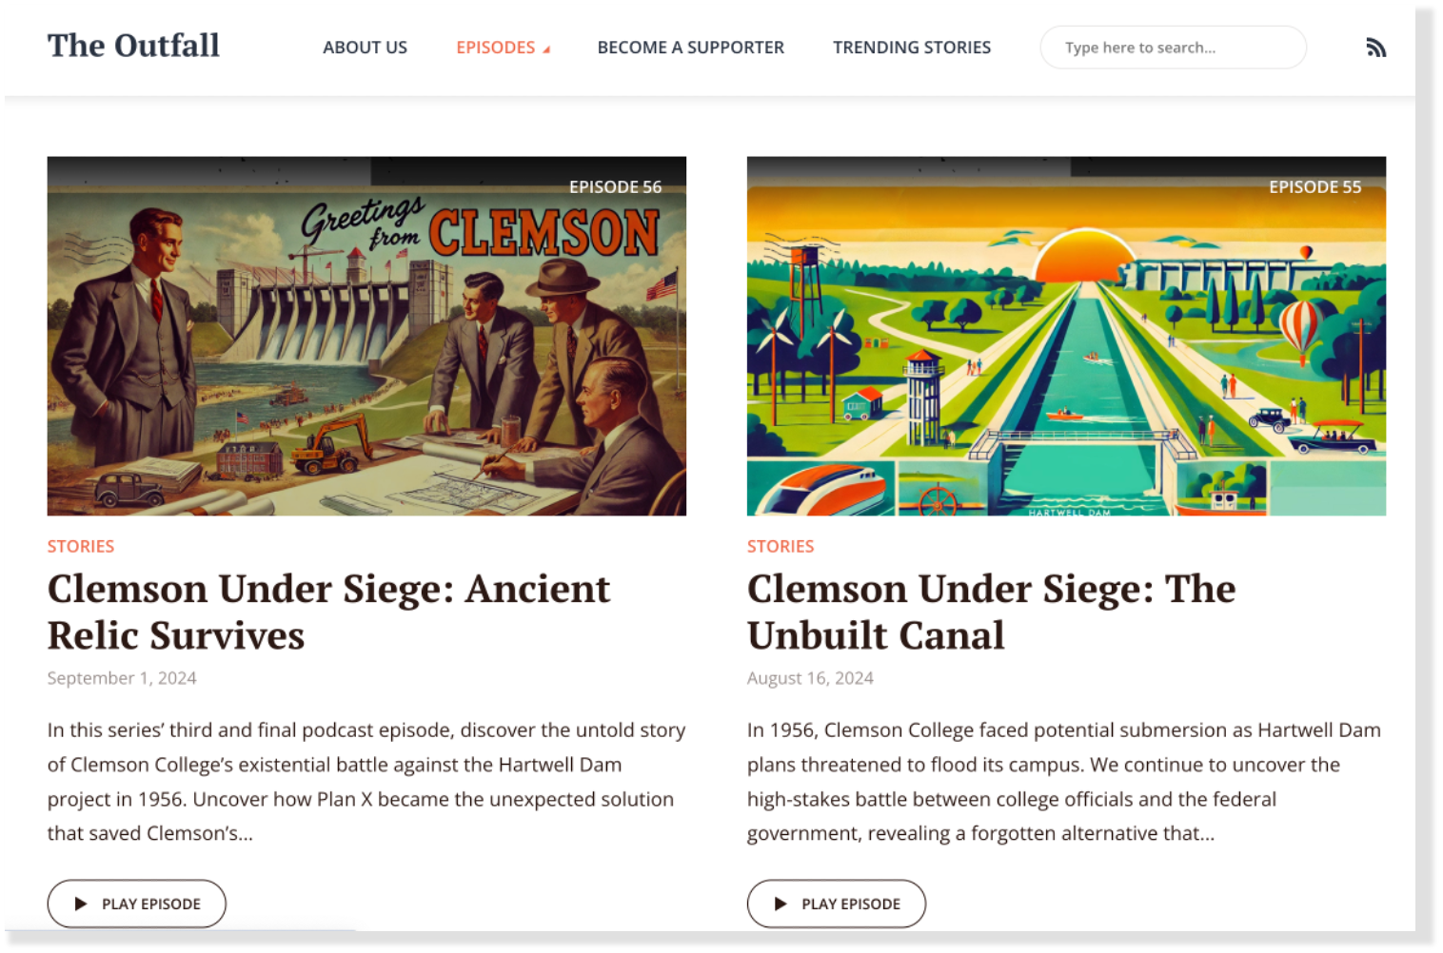
Notes:
Check out The Outfall podcast.

Slide 4
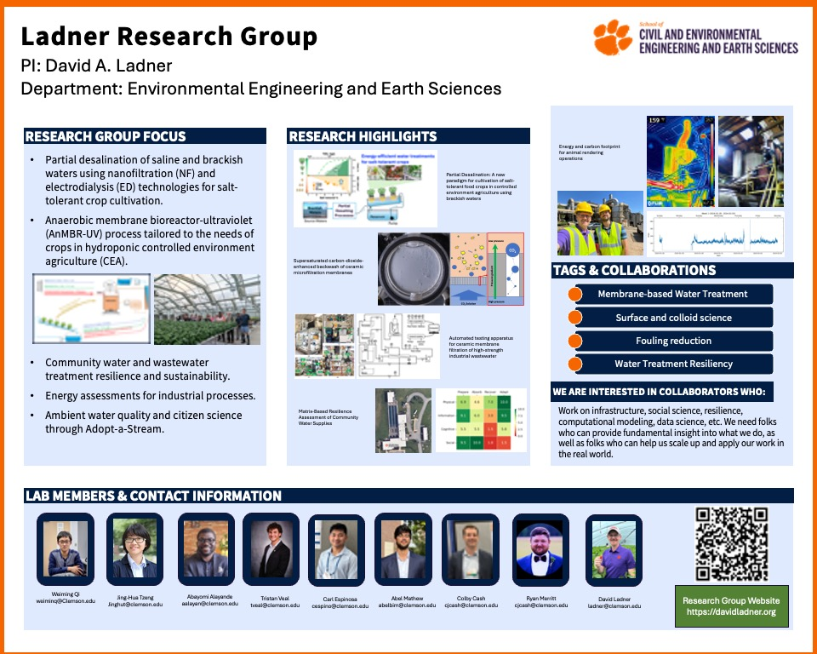

Research Group Website
https://davidladner.org

Slide 5
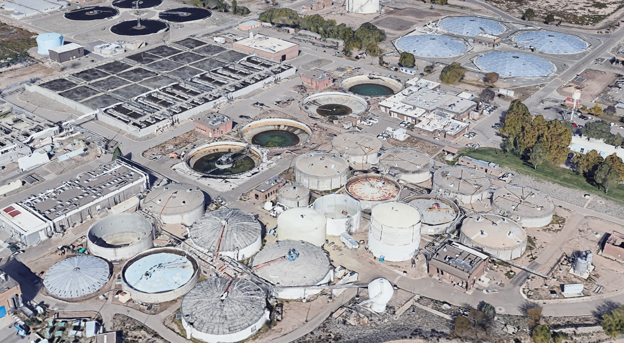
4201 2nd Street Southwest, Albuquerque, NM
Notes:
The main message today is think differently about infrastructure. We need design engineers who have a vision. You need to have a mental model of how

Slide 6
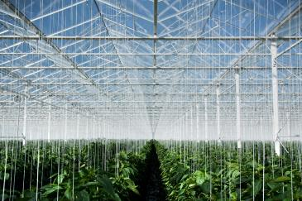
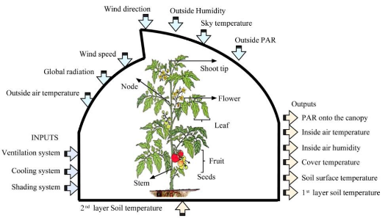
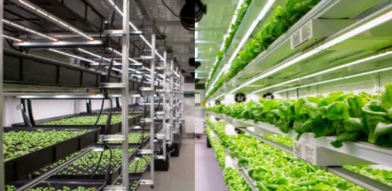
Controlled Environment Agriculture (CEA)
  Greenhouses or modular containers
  Controlled water, light, temperature, & ventilation
  Soil-based or hydroponic
  Vertical farming = vertically stacked layers
  Rural, peri-urban, and urban CEA
Inputs and outputs of CEA (Shamshiri et al., 2018)

Slide 7
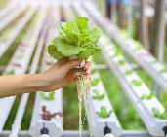
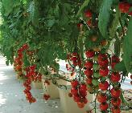
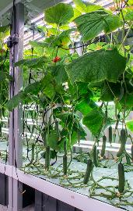
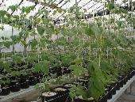
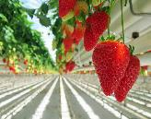
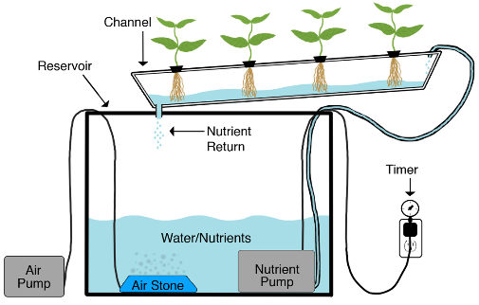
Hydroponic CEA Platform
Leafy greens Tomatoes Cucumber
High-value food crops that can be grown in hydroponic CEA
  Leafy greens, tomatoes, cucumbers, beans, and strawberries
  Water quality concerns:
    Impacts of water quality on crop yield
    Crop salt tolerance with saline/brackish water
    Pathogens with reclaimed municipal wastewater
    Plant bioaccumulation of metals etc. with urban stormwater
Nutrient delivery
  Nutrient Film Technique (NFT)
  NFT solution recycling
    Water and nutrient efficiency
    Plant pathogen control
Beans Strawberries
https://www.agritecture.com

Slide 8
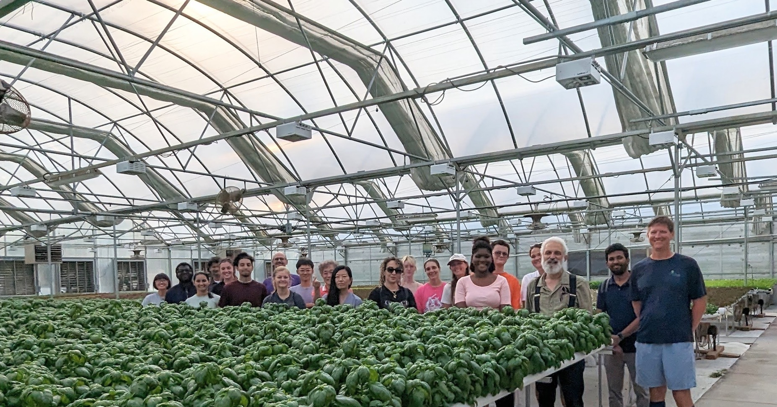

Slide 9
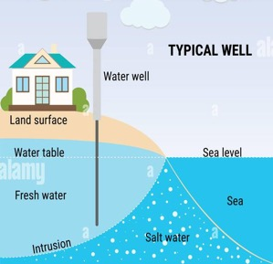
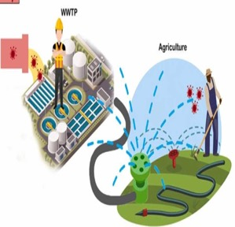
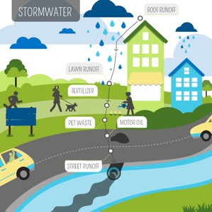
Water sources for agricultural irrigation
Conventional sources
  Freshwater from surface and groundwaters
  Increasingly impacted by regional droughts
Non-conventional (marginal quality) sources
  Saline/brackish surface and groundwaters (rural)
    Salinity
  Reclaimed municipal wastewater (centralized and decentralized)
    Human pathogens and chemical micropollutants, and plant pathogens
    Attribute: presence of nutrients (P & N)
  Urban stormwater (urban and peri-urban)
    Heavy metals, hydrocarbons, pesticides, PFAS, microplastics

Slide 10
Reclaimed Wastewater CEA Platform
blowdown (based on ET & salinity)
Final
Return
Flow
Residual
Biosolids
Supplemental
Nutrients (N, P, K)
Soil Conditioner
Recycling of
NFT Solution
(UF Filtration and/or UV)
High-Quality
Irrigation Water
w/ In Situ Nutrients
(N, P, K)
Balancing
Nutrients
(N, P. K)
Peri-Urban
Trunk Sewer
(Sewer
Mining)
Municipal
/Domestic Wastewater
Decentralized
Anaerobic Membrane
Bioreactor (AnMBR)
+ UV Disinfection
Crop Cultivation Platform
Hydroponic Approach
Greenhouse or
Modular Container
Vertical Farming
Nutrient Film Technique
Large-Scale
Residential Building
Energy
(Methane)
heat
heat, air-con, or
CO₂ enrichment
High
-Value
Crops
Plant Harvest
Wastes
Grinder
Decentralized integrated hydroponic CEA/NFT platform: Novel Wastewater Reclamation Scheme

Slide 11
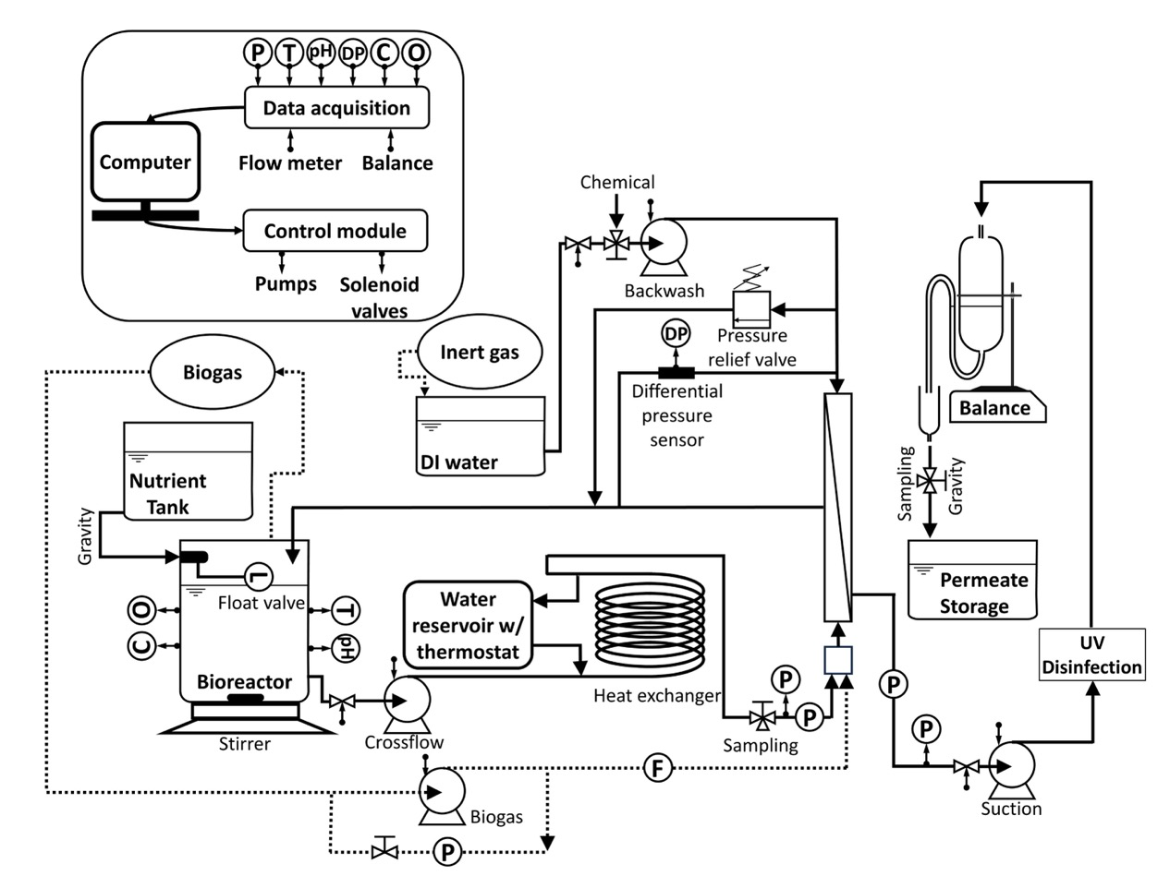
The AnMBR system realizes full automation and high-frequency data acquisition.
Bioreactor volume: ～9.6 L
Temp: 35 °C
Typical HRT: 18 hr
Typical SRT: multiple months
Typical OLR: 4 g/L/day
Data acquisition: 4-5 Hz
P: pressure
F: flowrate
O: ORP
C: conductivity
DP: differential pressure
Notes:
“Given decentralized locations, we will avoid the complexity of primary clarification and provide course screening only. Our reason for initially studying 35 C is more effective mesophilic conditions provided by heating the wastewater by biogas combustion.”

Slide 12
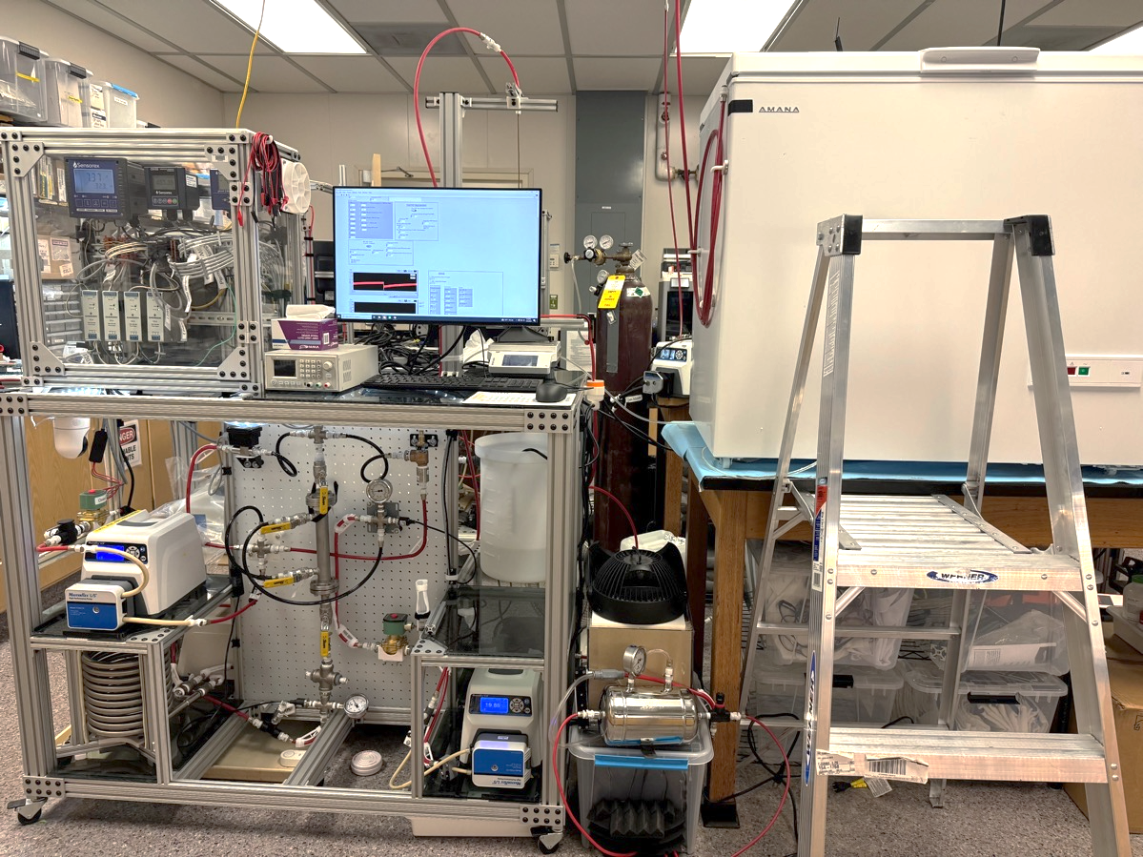
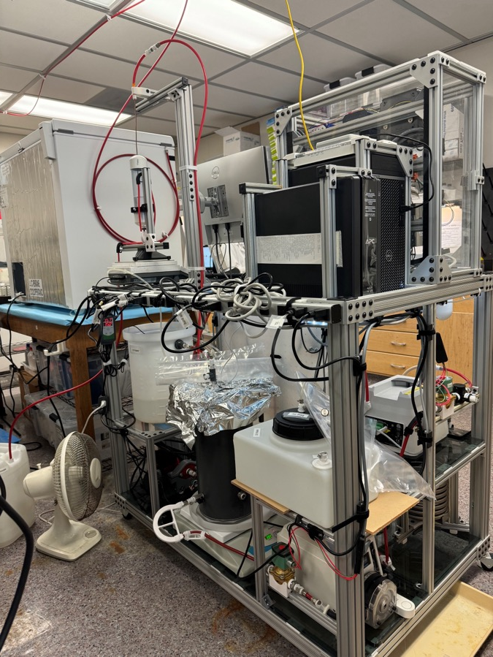
An automated AnMBR was constructed for continuous operation with minimal operator time commitment.
Electronics
Refridgerator for temperature control
Computer & UPS
Backwash tank
Water bath
Bioreactor
Liquid handling hardware
Air compressor
Circulation pump

Slide 13
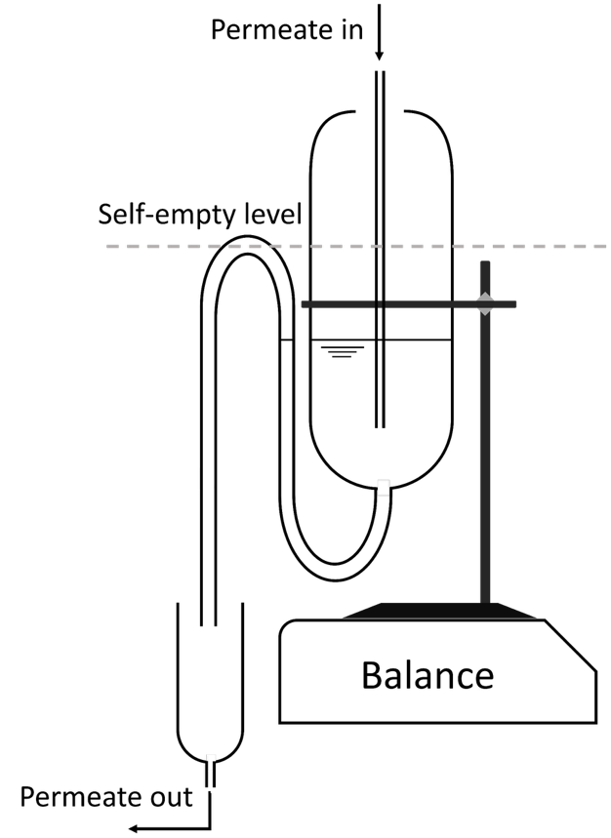
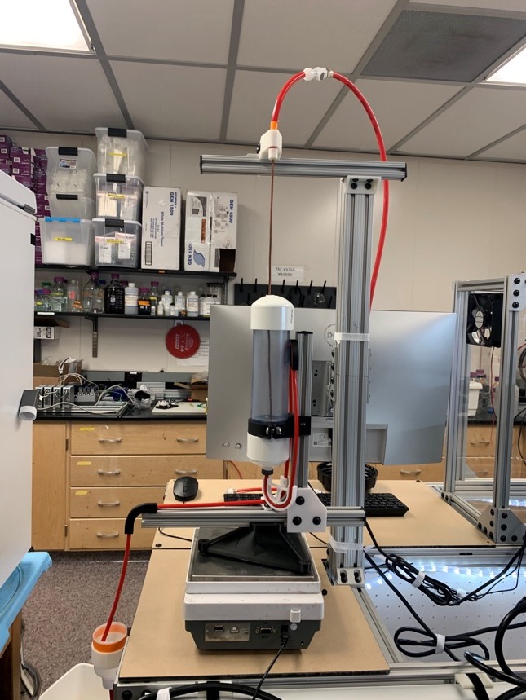
We built a flow meter using a balance and a “toilet” mechanism.
Tubing
Accumulation tank
Balance
Receiver

Slide 14
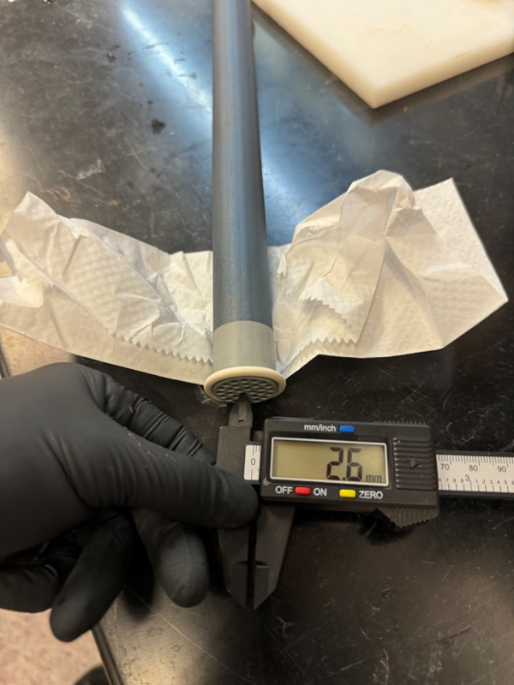
Filtration, backwash, and cleaning conditions
Filtration:
  Duration: 30 minutes
  Flux: 3.4-9.4 LMH
  Crossflow velocity: 0.12 – 0.19 m/s
Backwash
  Trigger: every 30 minutes
  Duration: 5 seconds
  Strength: 169 LMH (limited by pump)
  DI water
Super backwash
  Trigger: TMP > 5 psi
  Duration: 30 seconds
  Strength: 169 LMH
  DI water
Notes:
“Given decentralized locations, we will avoid the complexity of primary clarification and provide course screening only. Our reason for initially studying 35 C is more effective mesophilic conditions provided by heating the wastewater by biogas combustion.”

Slide 15
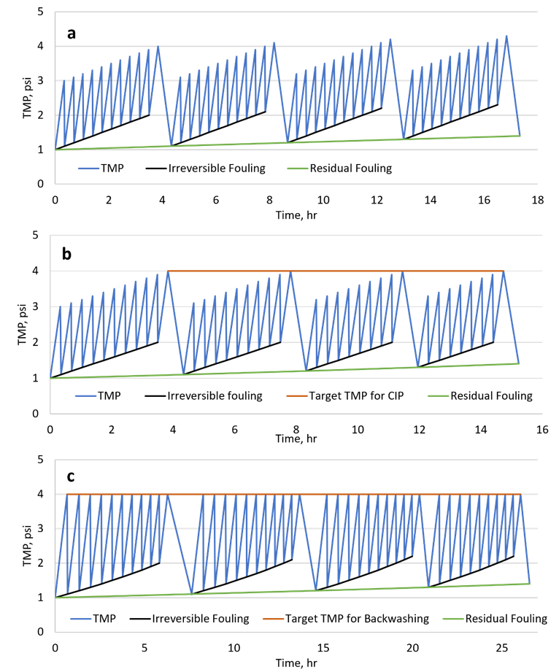
The program was coded in LabVIEW for full automation.
Cleaning strategies are the combinations of backwash and CEB triggers.
  Backwash
    Time
    TMP
  Chemical enhanced backwash
    Time
    TMP
    Duration
Filtration is controlled with the following criteria
  Constant flux
  Constant TMP
  Constant pump speed
Qi, Weiming, & David A. Ladner. Journal of Environmental Engineering, 2023, 149(10): 04023063.

Slide 16
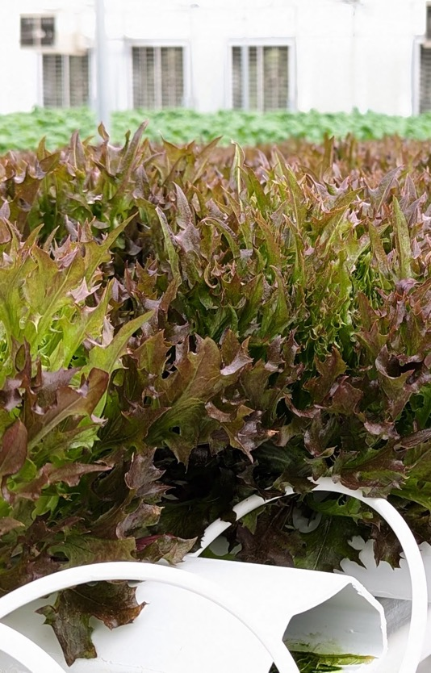
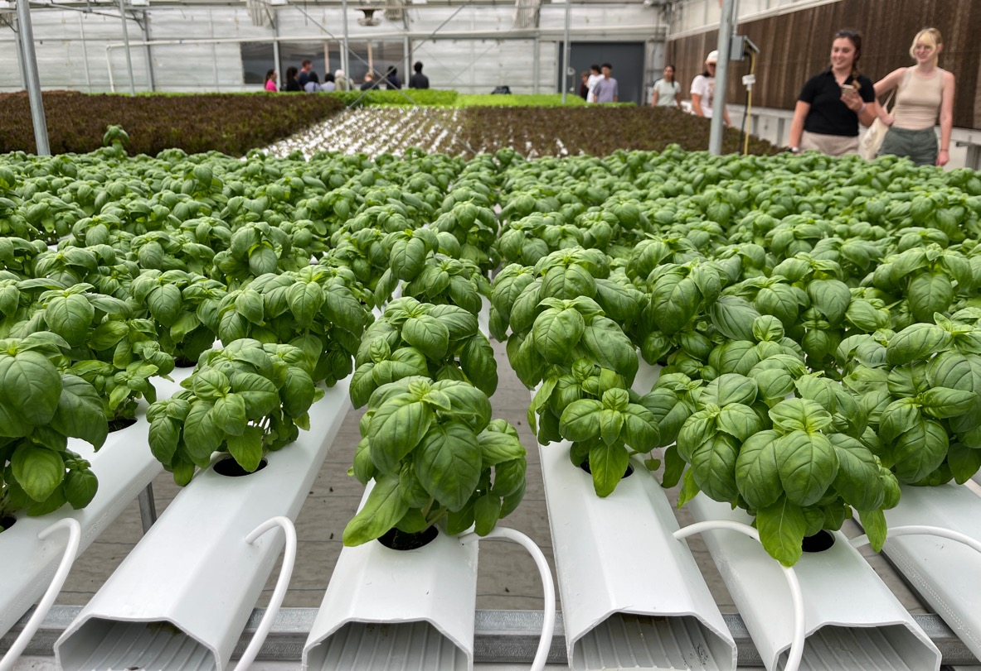
We are augmenting the AnMBR with harvest waste for resource recovery.

Slide 17
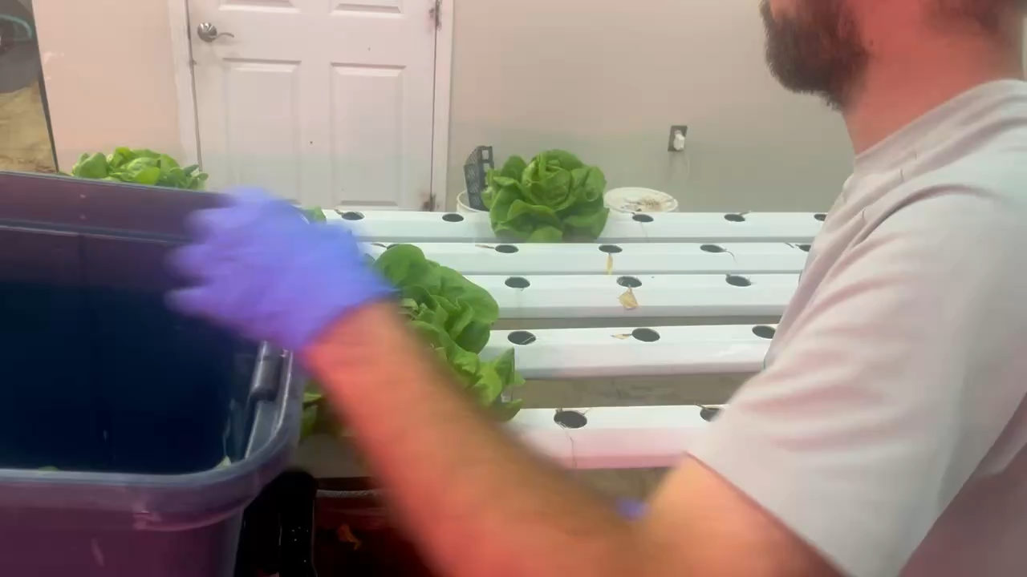
Harvest waste collection

Slide 18
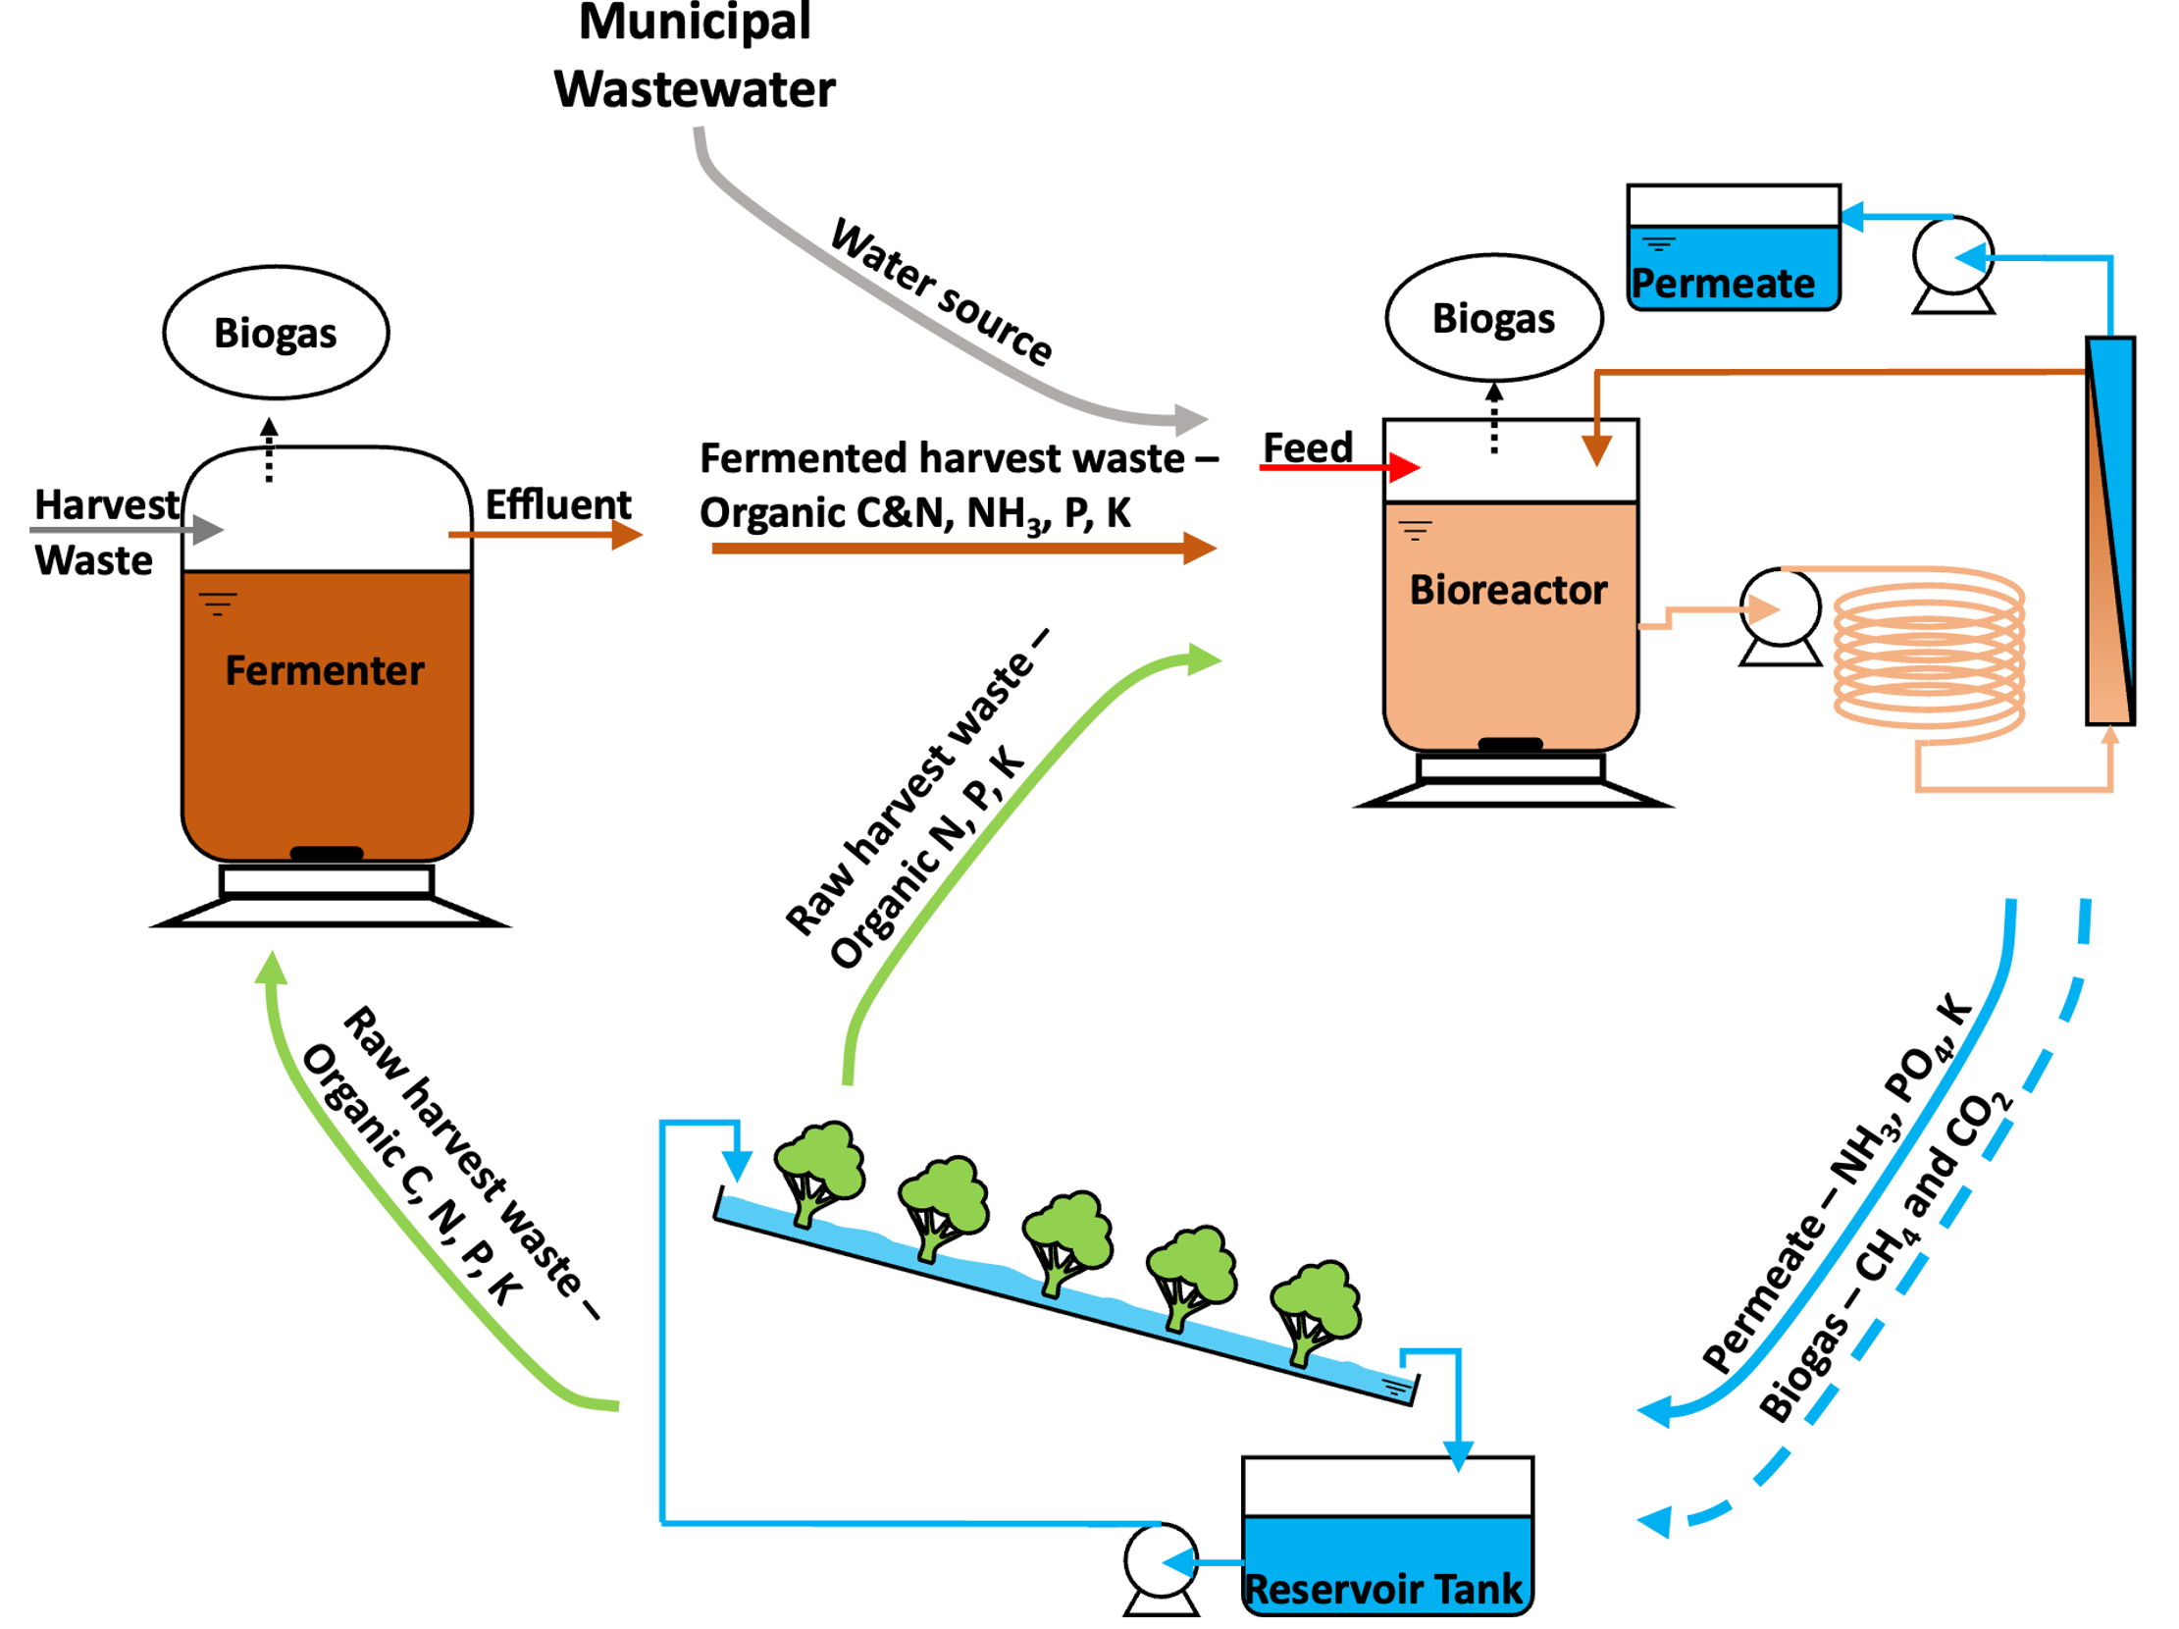
Cotreatment of harvest waste and municipal wastewater
How fermenter helps
Bioreactor performance
Membrane performance
Nutrients

Slide 19
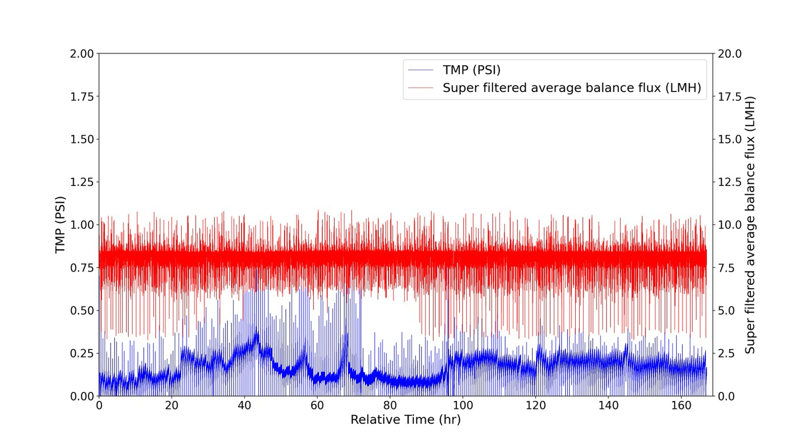
Membrane performance - Raw data

Slide 20
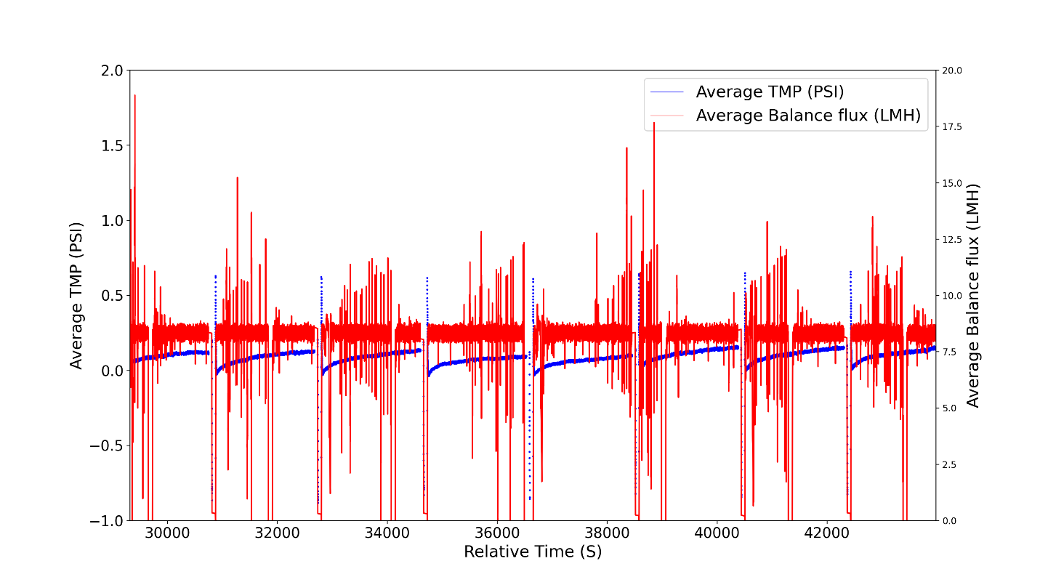
Membrane performance – Raw data

Slide 21
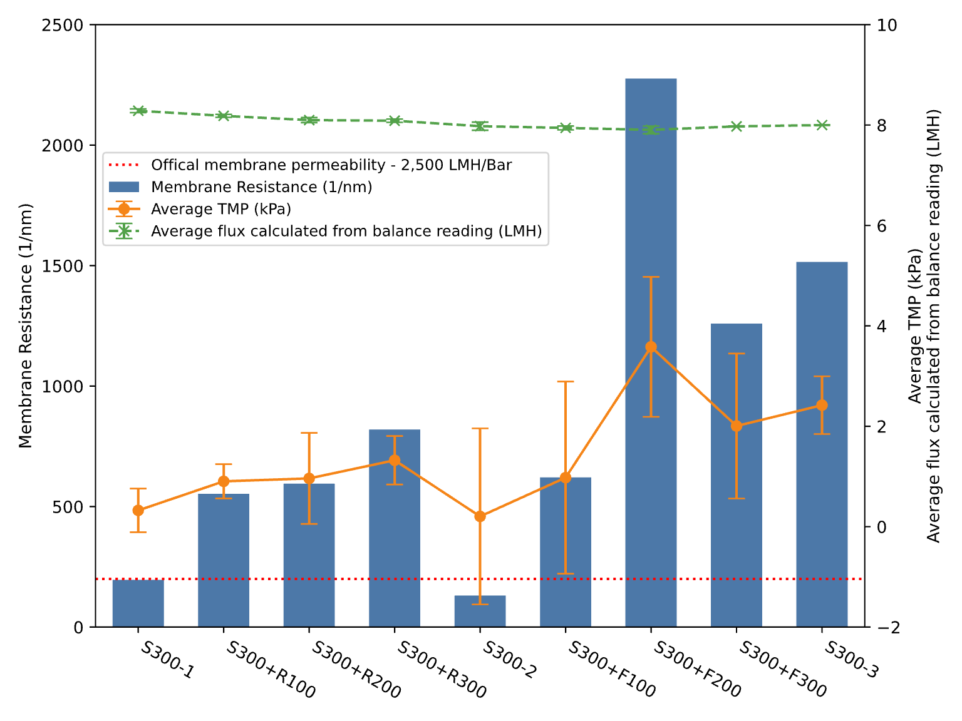
Membrane performance - Resistance

Slide 22
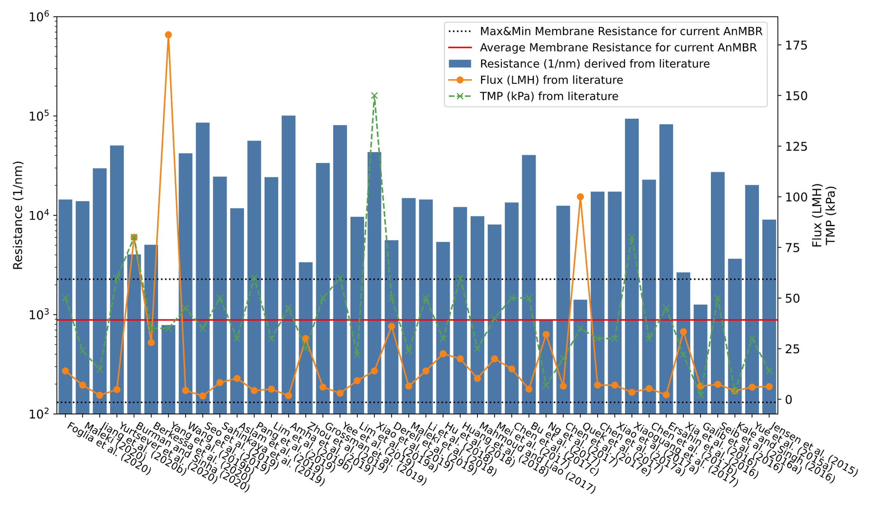
Membrane performance - Resistance

Slide 23
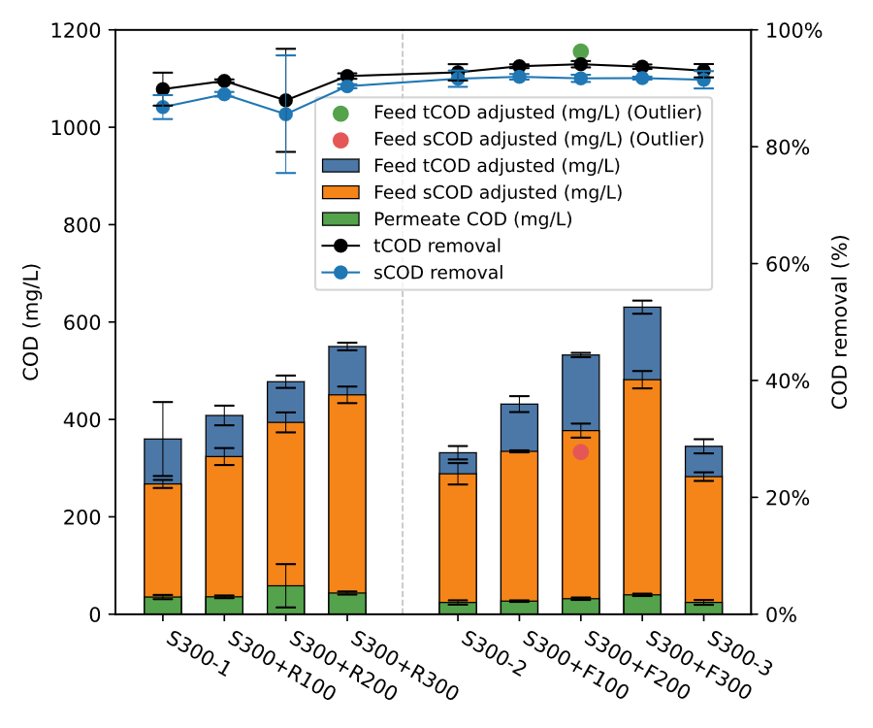
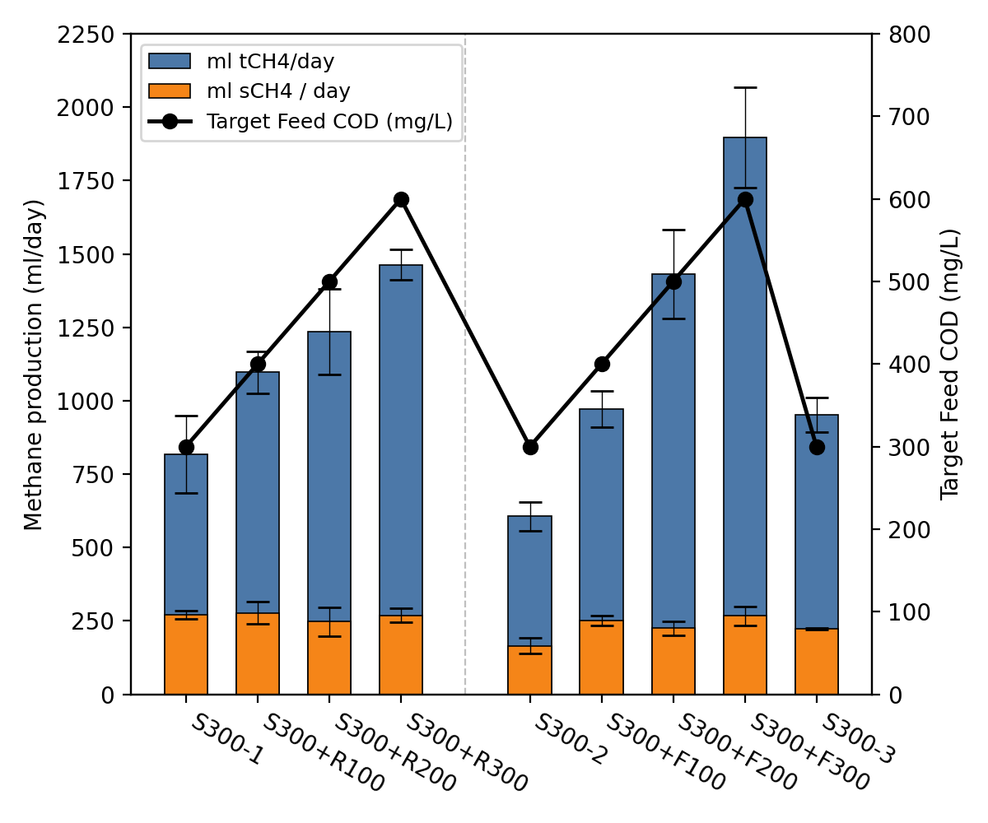
Bioreactor performance

Slide 24
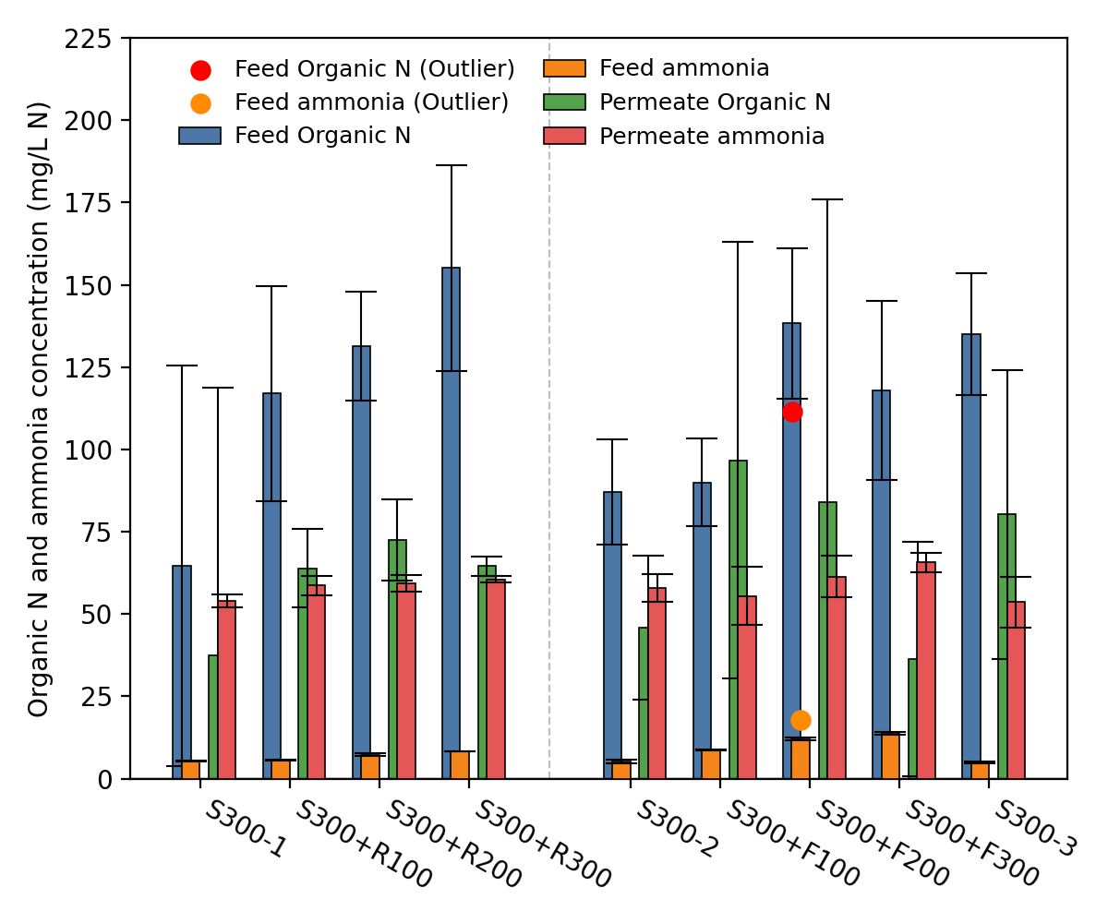
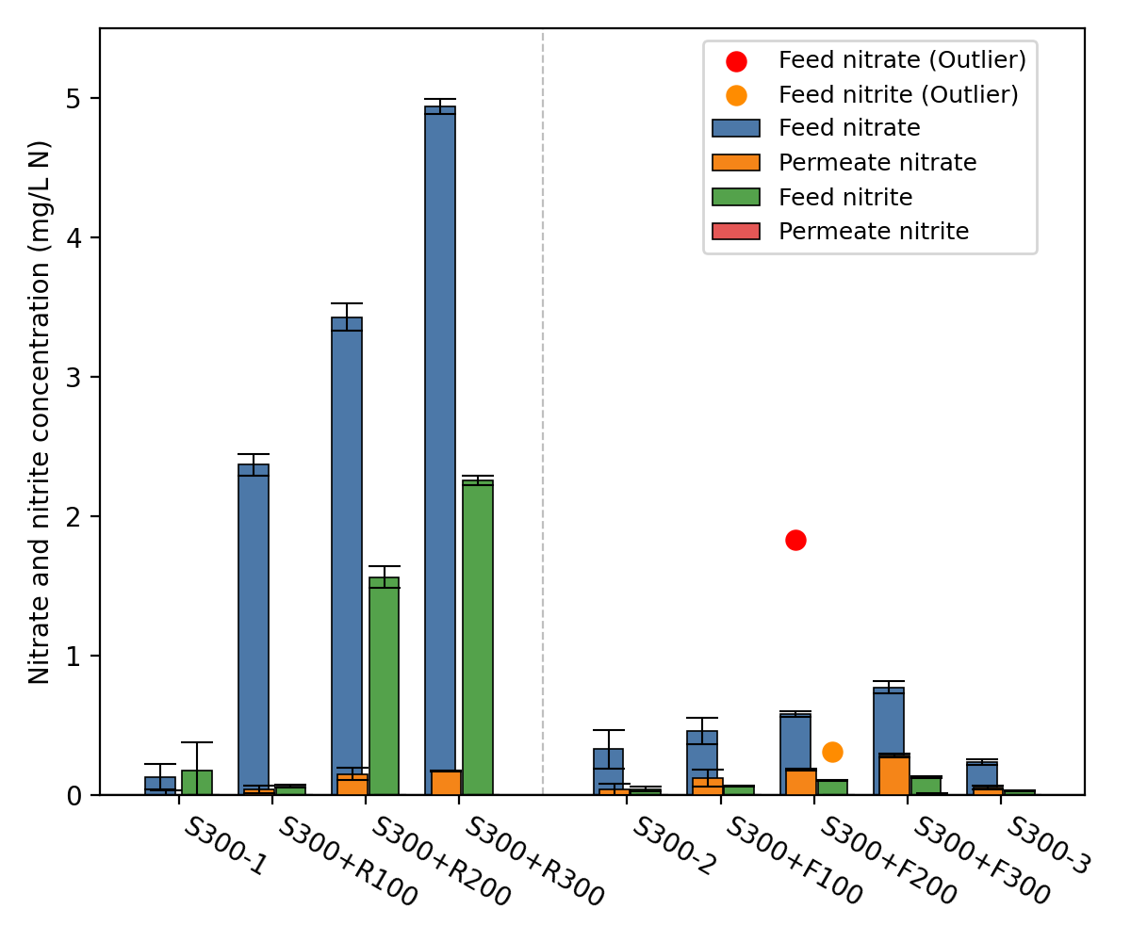
Nutrients - N

Slide 25
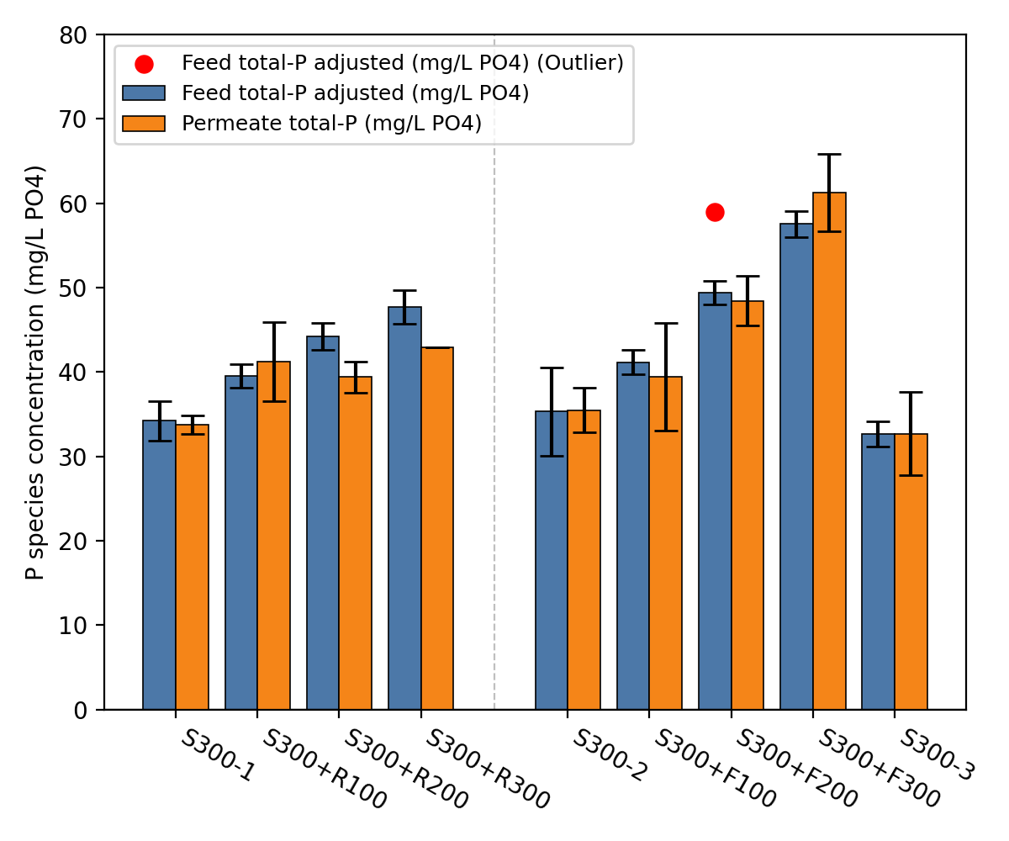
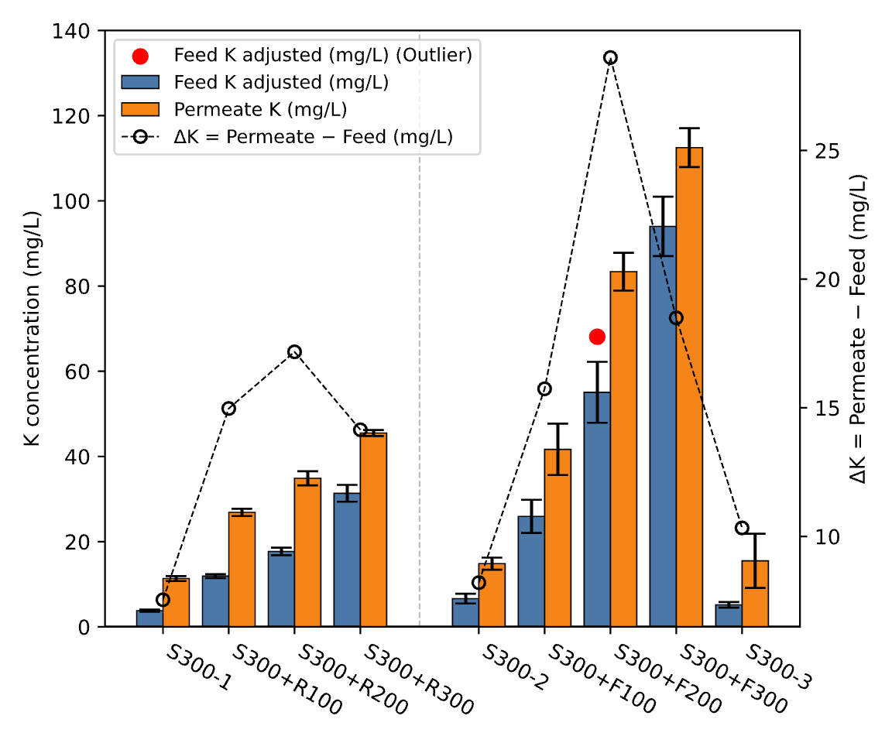
Nutrients – P and K

Slide 26
4201 2nd Street Southwest, Albuquerque, NM
Notes:
The main message today is think differently about infrastructure. We need design engineers who have a vision. You need to have a mental model of how

Slide 27
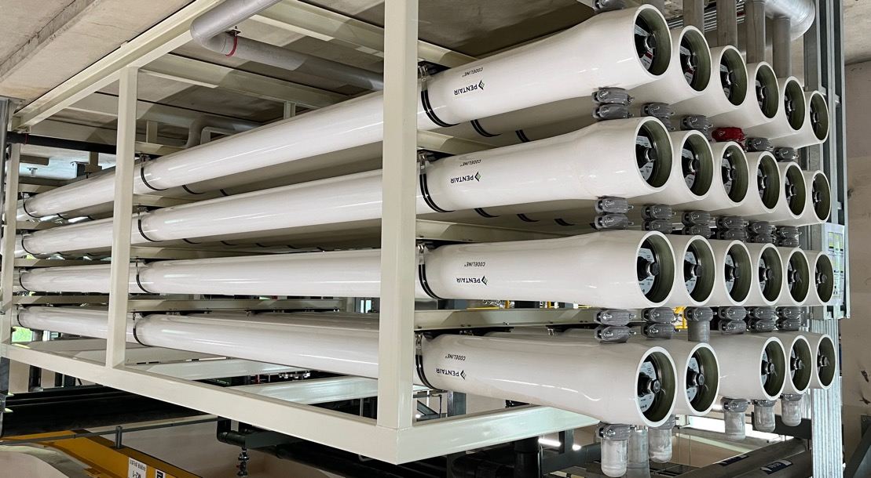
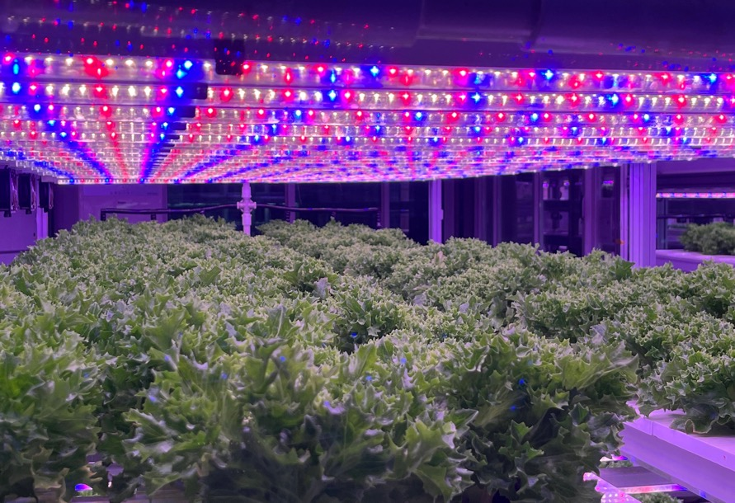

Partial Desalination Using Reverse Osmosis and Nanofiltration for
Salt-Tolerant Hydroponic Crops
Jing-Hua Tzeng, David A. Ladner, W. Shane Walker, Clinton Williams, Geethakrishna Puligundla, R. Karthikeyan, & Gary Amy

Slide 28


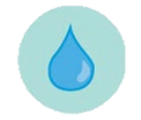

29
Goal
29
To develop a new paradigm of desalination for the agriculture sector,
  partial desalination (focus on NF innovations) whereby tailored water quality is produced in accordance with the salinity tolerance of target crops.
NF Partial Desalting Processes
Hydroponic system
1S
Key Criteria
Brackish
Waters
1S-CR
Energy
1S-ISD
Water Quality
Recovery
(quantity)
CC
2S
Low water use
No soil use
3S
(Tzeng et al., Desalination 613 (2025) 119072)
Notes:
no soil
2 to 48 times less water use

Slide 29




30
Crop Yield, Water Quality (TDS) & Energy Consumption
of Different Desalting Scenarios
Save the freshwater for drinking water purposes
Food
Specific Energy Consumption
(SEC)
~16 dS/m
Water
Diluted Seawater (SW) @10,000 mg/L
simulate a coastal groundwater aquifer
(Data source: Tzeng et al., (2025), Maas and Hoffman (1977), Wallender and Tanji (2011), and International Water Management Institute (IWMI, 2004).
Notes:
Brackish water for agricultural purpose
Market

Slide 30


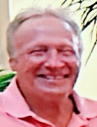



Desalting processes
31
Evaluation Criteria:
Specific Energy Consumption (SEC)
Recovery (%) (Water Quantity)
Water Quality (TDS)
Brackish Waters
Partial Desalting Process
Complete Desalting Process
Gary Amy
David Ladner
Clinton Williams
Jing-Hua Tzeng
Water Quantity:
Feed water (100%)
− Recovery %
(= Product/Feed)
= Brine %
Reverse Osmosis (RO)
Nanofiltration (NF)
Electrodialysis (ED)
Blending
1S
1S-CR
1S-ISD
CC
2S
3S
Permeate/ Product
Brine
Brine
Management
Nutrient Solution Tank
w/ Water for plant growth
Nutrients Stock
Permeate/
Product water
Processed
Saline Water
Notes:
Cost
Recovery%
Brine cost

Slide 31
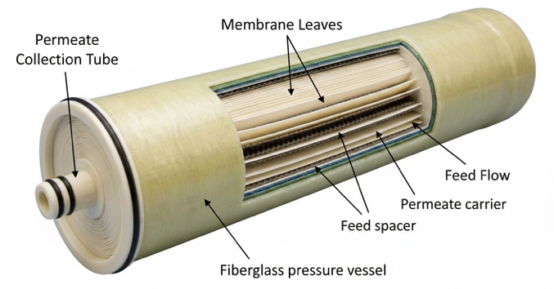
Nanofiltration (NF) Modeling
32
Input
Output
Feed Flowrate: 2.1 m³/h
Feed TDS: 10,000 mg/L
Variable:
  # of Stage: 1, 2, 3
  # of pressure vessels (PV): 1 per stage
  # of elements per PV:
    6 at 1st stage,
    2 to 4 at 2nd stage;
    3 at 3rd stage (2.5-inch element)
Feed pressure (1st stage): 10-40 bar
Boost pressure (2nd and 3rd stages): 20-40 bar
Concentrate recycle
Internally staged design (ISD)
Closed circuit
Membrane type: NF90, NF200, BW30
Flowrate (m³/h): Feed, Conc., Permeate
Perm Flux (LMH)
Recovery (%)
Feed pressure (bar)
Water quality:
  TDS (mg/L): Feed, Conc., Perm.
  Ion concentration: Feed, Conc. Perm.
  pH
Utility & Chemical cost
  SEC (kWh/m³)
WAVE
DuPont

Slide 32
1S vs. 1S-CR
33
1-stage
1S-CR
1S
Permeate (Product)
Feed
Permeate (Product)
Feed
Concentrate
Concentrate
Pressure Vessel
Valve
Max. pressure
NF90
NF90
CR = 70, 50 %
CR 70%
CR 70%
CR 50%
CR 50%
CR = 70, 50, 30 %
CR 30%
Same pressure
As CR% Recovery% & SEC
Higher
Recovery%

Slide 33
1S-ISD (Internally Staged Design)
34
1S-ISD
Feed
Permeate (Product)
Concentrate
Same pressure
Same pressure
# of Tighter membrane
Recovery%
SEC
# of Looser membrane
Recovery%
SEC

Slide 34


CC (Closed Circuit)
35
CC
Feed
Permeate (Product)
Concentrate (periodic blowdown)
Membrane
Cross-section
4-inch
# of elements
pressure & SEC
NF90
Input:
NF90, Recovery %
8-inch
Size of elements
pressure &SEC

Slide 35
2S with various numbers of elements
36
2-stages
2S
Feed
Permeate (Product)
Boost
Concentrate
2nd stage
2nd stage
2nd stage
2nd stage
2nd stage
1st stage
2nd stage
2nd stage
1st stage
1st stage
1st stage
1st stage

Slide 36
2S with various numbers of elements
37
2-stages
2S
Feed
Permeate (Product)
Boost
Concentrate
@ Variable 1st Stage Pressures and
Constant 2nd Stage Pressures.
@ Constant 1st Stage Pressures and
Variable 2nd Stage Pressures.
6:2
6:2
6:3
6:3
6:4
6:4
1st stage pressure
Recovery%
SEC
# of 2nd stage element
Recovery %
SEC

Slide 37
3S
38
3-stages
3S
Feed
Boost
Permeate (Product)
Boost
Concentrate
1st & 2nd stage pressure
Recovery% SEC
3rd stage pressure
Recovery% SEC

Slide 38
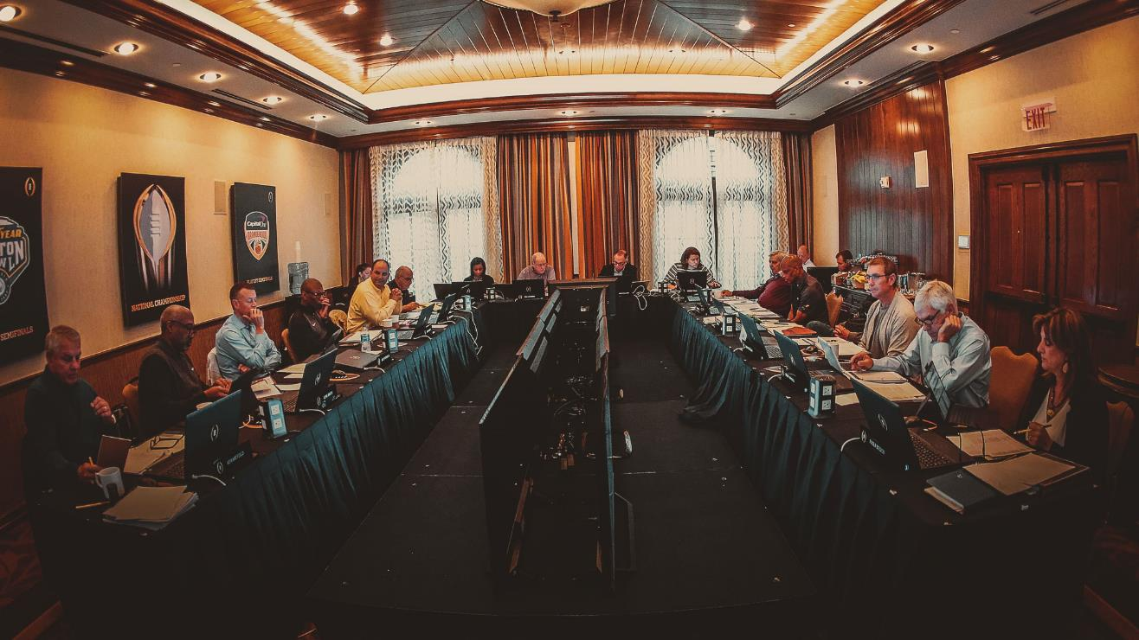
Notes:
The committee got together, kind of like the college football playoff selection committee. And we decided which configuration was best.

Slide 39
General Rating of NF Processes based on the parameter chosen
40
Rating
Membranes | Configurations | TDS | Recovery | SEC
NF90 | 1S
 | 1S-CR
 | CC
 | 2S
 | 3S
NF90+NF200 | 1S-ISD
NF200 | 1S
 | 1S-CR
 | CC
 | 2S
 | 3S
1S
High
1S-CR
Low
1S-ISD
CC
2S
3S

Slide 40
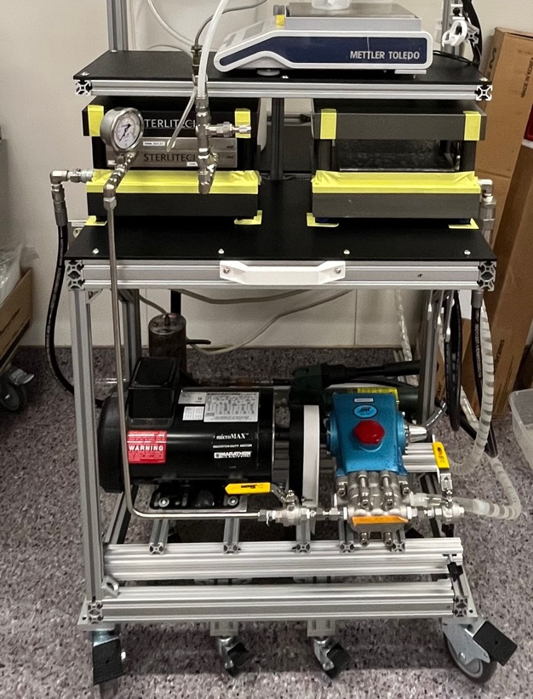
Ongoing Work
41
Bench-Scale Nanofiltration Experiments
Membrane properties:
  Surface charge
  Pore size
  Molecular weight cutoff (MWCO)
Operating Conditions:
  Applied pressure
  Flux
  Recovery

Slide 41
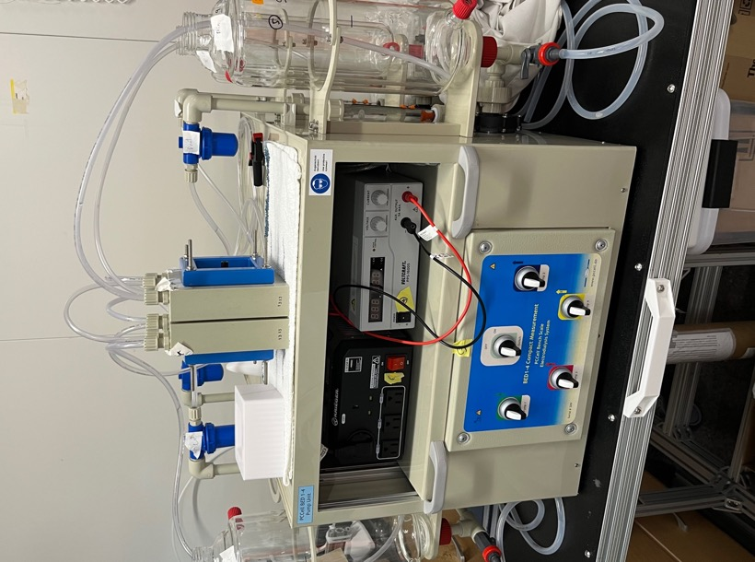







Ongoing Work
42
Bench-Scale Electrodialysis Experiments
Ion Exchange Membranes
Conventional
Monovalent selective
Concentrate:
Na⁺, Cl⁻, Ca²⁺, Mg²⁺, SO₄²⁻
Product Water:
Low in ions
Product Water:
Ca²⁺, Mg²⁺, SO₄²⁻
Concentrate:
Na⁺, Cl⁻
CEM
AEM
mCEM
Na⁺
Na⁺
mAEM
+
Na⁺
-
+
Na⁺
-
Cl⁻
Cl⁻
Cl⁻
Cl⁻
Mg²⁺
SO₄²⁻
Mg²⁺
SO₄²⁻
Feedwater:
Na⁺, Cl⁻, Ca²⁺, Mg²⁺, SO₄²⁻
Feedwater:
Na⁺, Cl⁻, Ca²⁺, Mg²⁺, SO₄²⁻

Slide 42



Acknowledgments
43
USDA-SAS Project Team members: David Ladner, Gary Amy, Clinton Williams, R. Karthikeyan, Azeezahmed Shaik, Chandrasekar S. Kousik, Rohit Dilip Kambale, Jeffrey Adelberg, Morgan Tomlin
Co-authors: W. Shane Walker, Robert Huehmer
Ladner Research Group members: Weiming Qi, Geethakrishna Puligundla, Riley Schrader, Anna Reynolds, Zachary Padgett, Spencer Jackson, Jackson Sholl, Olivia Mucci, Timothy Ziegler
Rich Lab: Daekyun Kim, Rodney Morgan, Kelli McCourt
USDA NIFA SAS Award # 2023-69012-39038: Controlled Environment Agriculture Platform for Cultivation of Salt-Tolerant Crops with Integrated Saline Water Irrigation and Salinity Management.

Slide 43
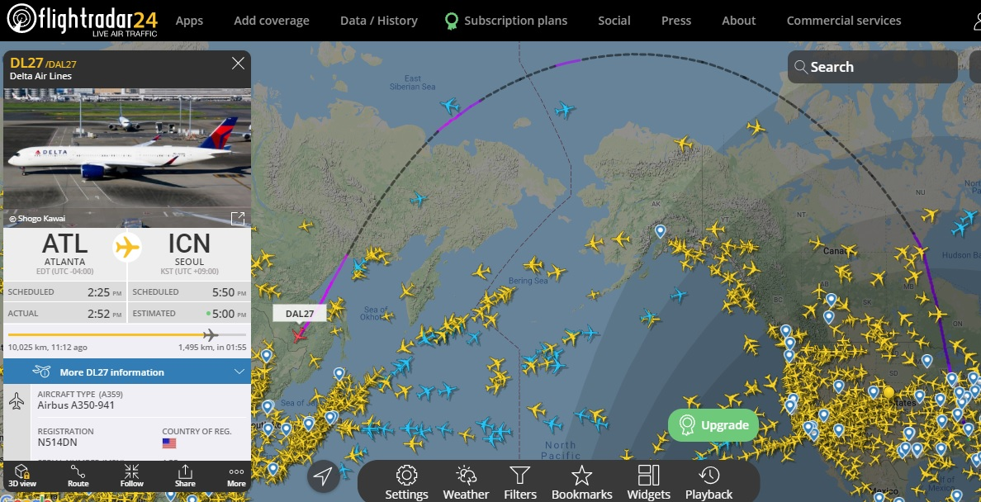
Notes:
This project is an international collaboration between S. Korea and S. Carolina. S. Korea is 38 degrees N. S. Carolina is 36 degrees N.

Slide 44
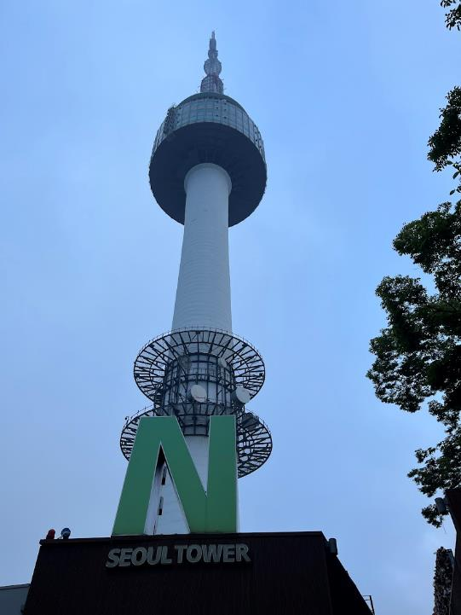
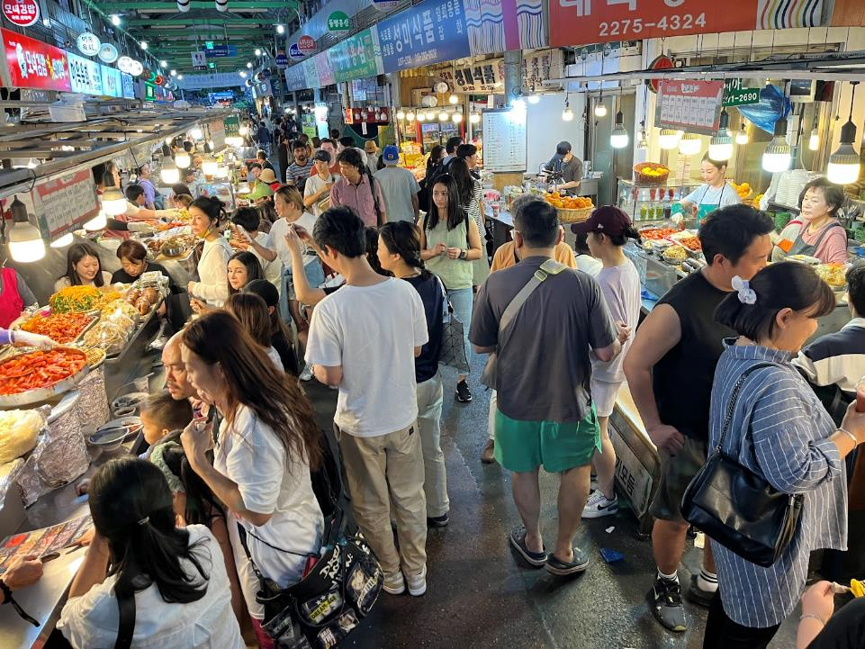
Notes:
Seoul is an amazing city. Very well organized. Great access to food. Great walkability. Many sustainability initiatives. Core message here: S. Korea is ahead of S. Carolina. Especially in population. Our goal today is to see where we want to take South Carolina into the future, especially with respect to agriculture and water treatment. When we look at S. Korea, we are looking at a possible future for S. Carolina. What lessons can we learn? How do we want to shape our state moving forward?

Slide 45

Notes:
In the heart of that municipal development are parks, recreation facilities, and wastewater treatment plants!

Slide 46

Notes:
The plant is underground.

Slide 47

Notes:
Advanced wastewater treatment: ozone/UV advanced oxidation.

Slide 48

Notes:
Reverse osmosis for salt removal. These kinds of plants, underground, can be distributed. Instead of Plumb Island, we could have several underground plants. Smaller, distributed, modular. And we can treat the water in the locations where the reuse is needed.

Slide 49

Notes:
So the wastewater treatment plants are underground and we found a greenhouse on top of a building.

Slide 50


Slide 51


Slide 52


Slide 53


Slide 54


Slide 55

Notes:
Growing food near population centers. In the suburbs. Energy intensive, yes. But has some advantages.

Slide 56

Notes:
Prof. SK Hong shows us a diagram of a wastewater treatment process flow.

Slide 57

Notes:
Key note: this is directly used for Samsung. They are mandated to use reclaimed wastewater rather than fresh water resources. This is an excellent model for South Carolina. New industry is moving in. They don’t need our fresh water supplies. Let’s have them build the wastewater reuse facilities they need.

Slide 58

Notes:
Their process water requirements are high, but they don’t need to worry so much about public perception and public health. This is why it makes sense to send our reclaimed water for industrial reuse.

Slide 59

Notes:
Professor Adelberg drank the Kool-Aid.

Slide 60

Notes:
Beautiful area. Growing rice.

Slide 61

Notes:
Rice being planted in a rural area. These valleys have been farmed for centuries. They understand nutrient cycling. As we in S. Carolina move toward the future, let’s think carefully about how we organize our agriculture/water systems to achieve the same sort of sustainability. And let’s use the lessons learned from population centers in other places in the world, to predict the future and shape it according to the way we want it to be.

Slide 62

Notes:
Our trip shifted to the rural areas.

Slide 63


Acknowledgements
Award #2230696
Notes:
This talk fits great with Myra Reece’s talk. waterSC group can learn from examples like S. Korea.

Slide 64



Notes:
Hydrogen peroxide and UV advanced oxidation kills viruses.

Slide 65

Notes:
So the key question for us is where to put these kinds of facilities? S. Korea has them covering the valleys. Mountainous areas are preserved. For South Carolina, where do we want to go? Use brownfield and industrial areas. Let’s preserve the farmlands, forest-lands, etc. We can grow so much food in the city!

Slide 66

Notes:
Strawberries are an example crop.

Slide 67

Notes:
These folks know about nutrient cycling and protection of groundwater.

Slide 68

Notes:
Fertilizer application is where we see nutrient cycling. For S. Carolina, if we can move toward wastewater reclamation, we can potentially recover nutrients.

Slide 69


